Slide 1
The full picture
What will you develop by the end of this training?

Slide 2
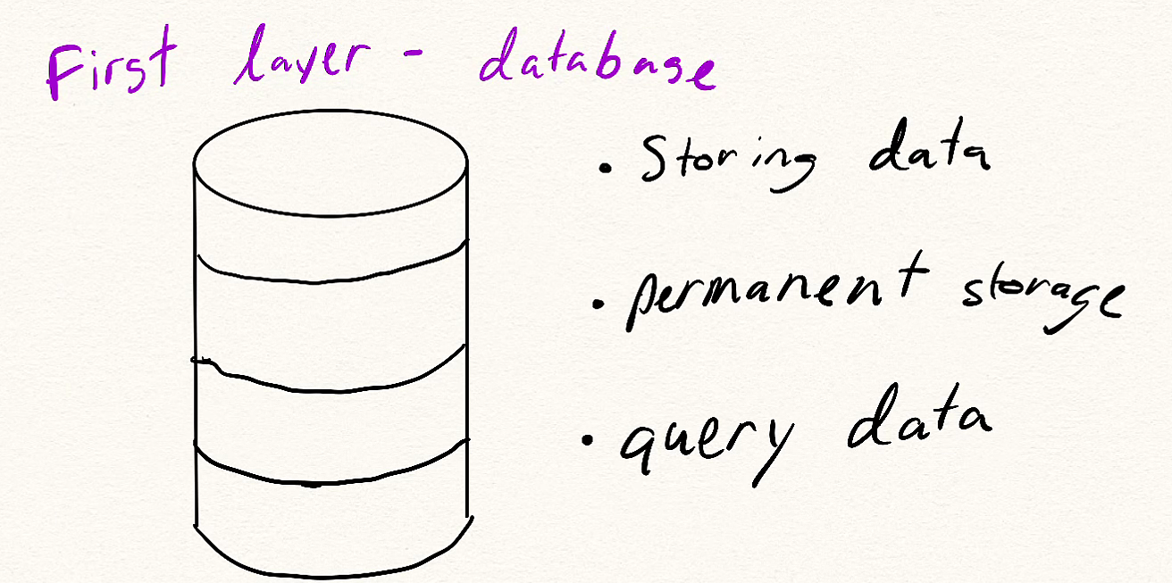
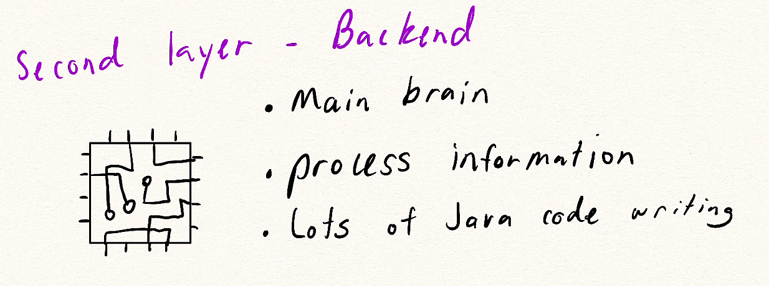
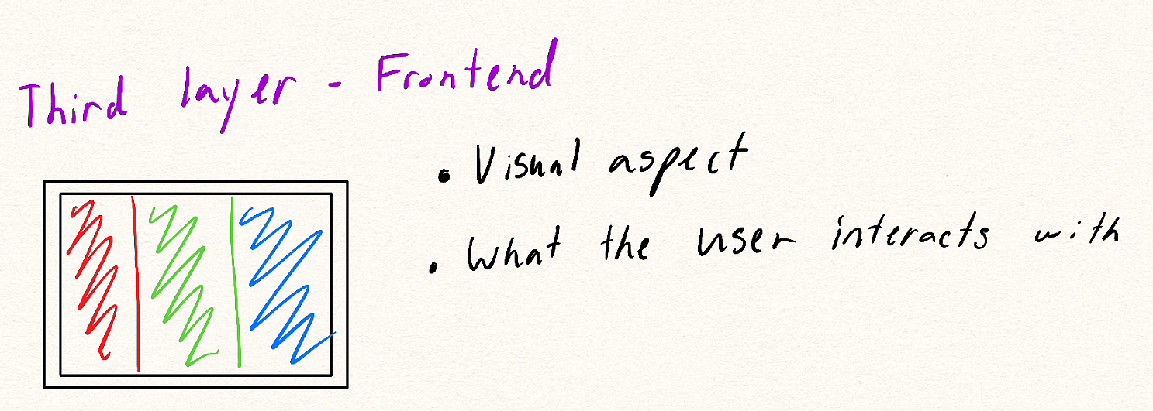
Java Full Tech Stack
There will be a ton of different languages and technologies required.
There are many ways to accomplish the same thing. (This will be one big way)

Slide 3
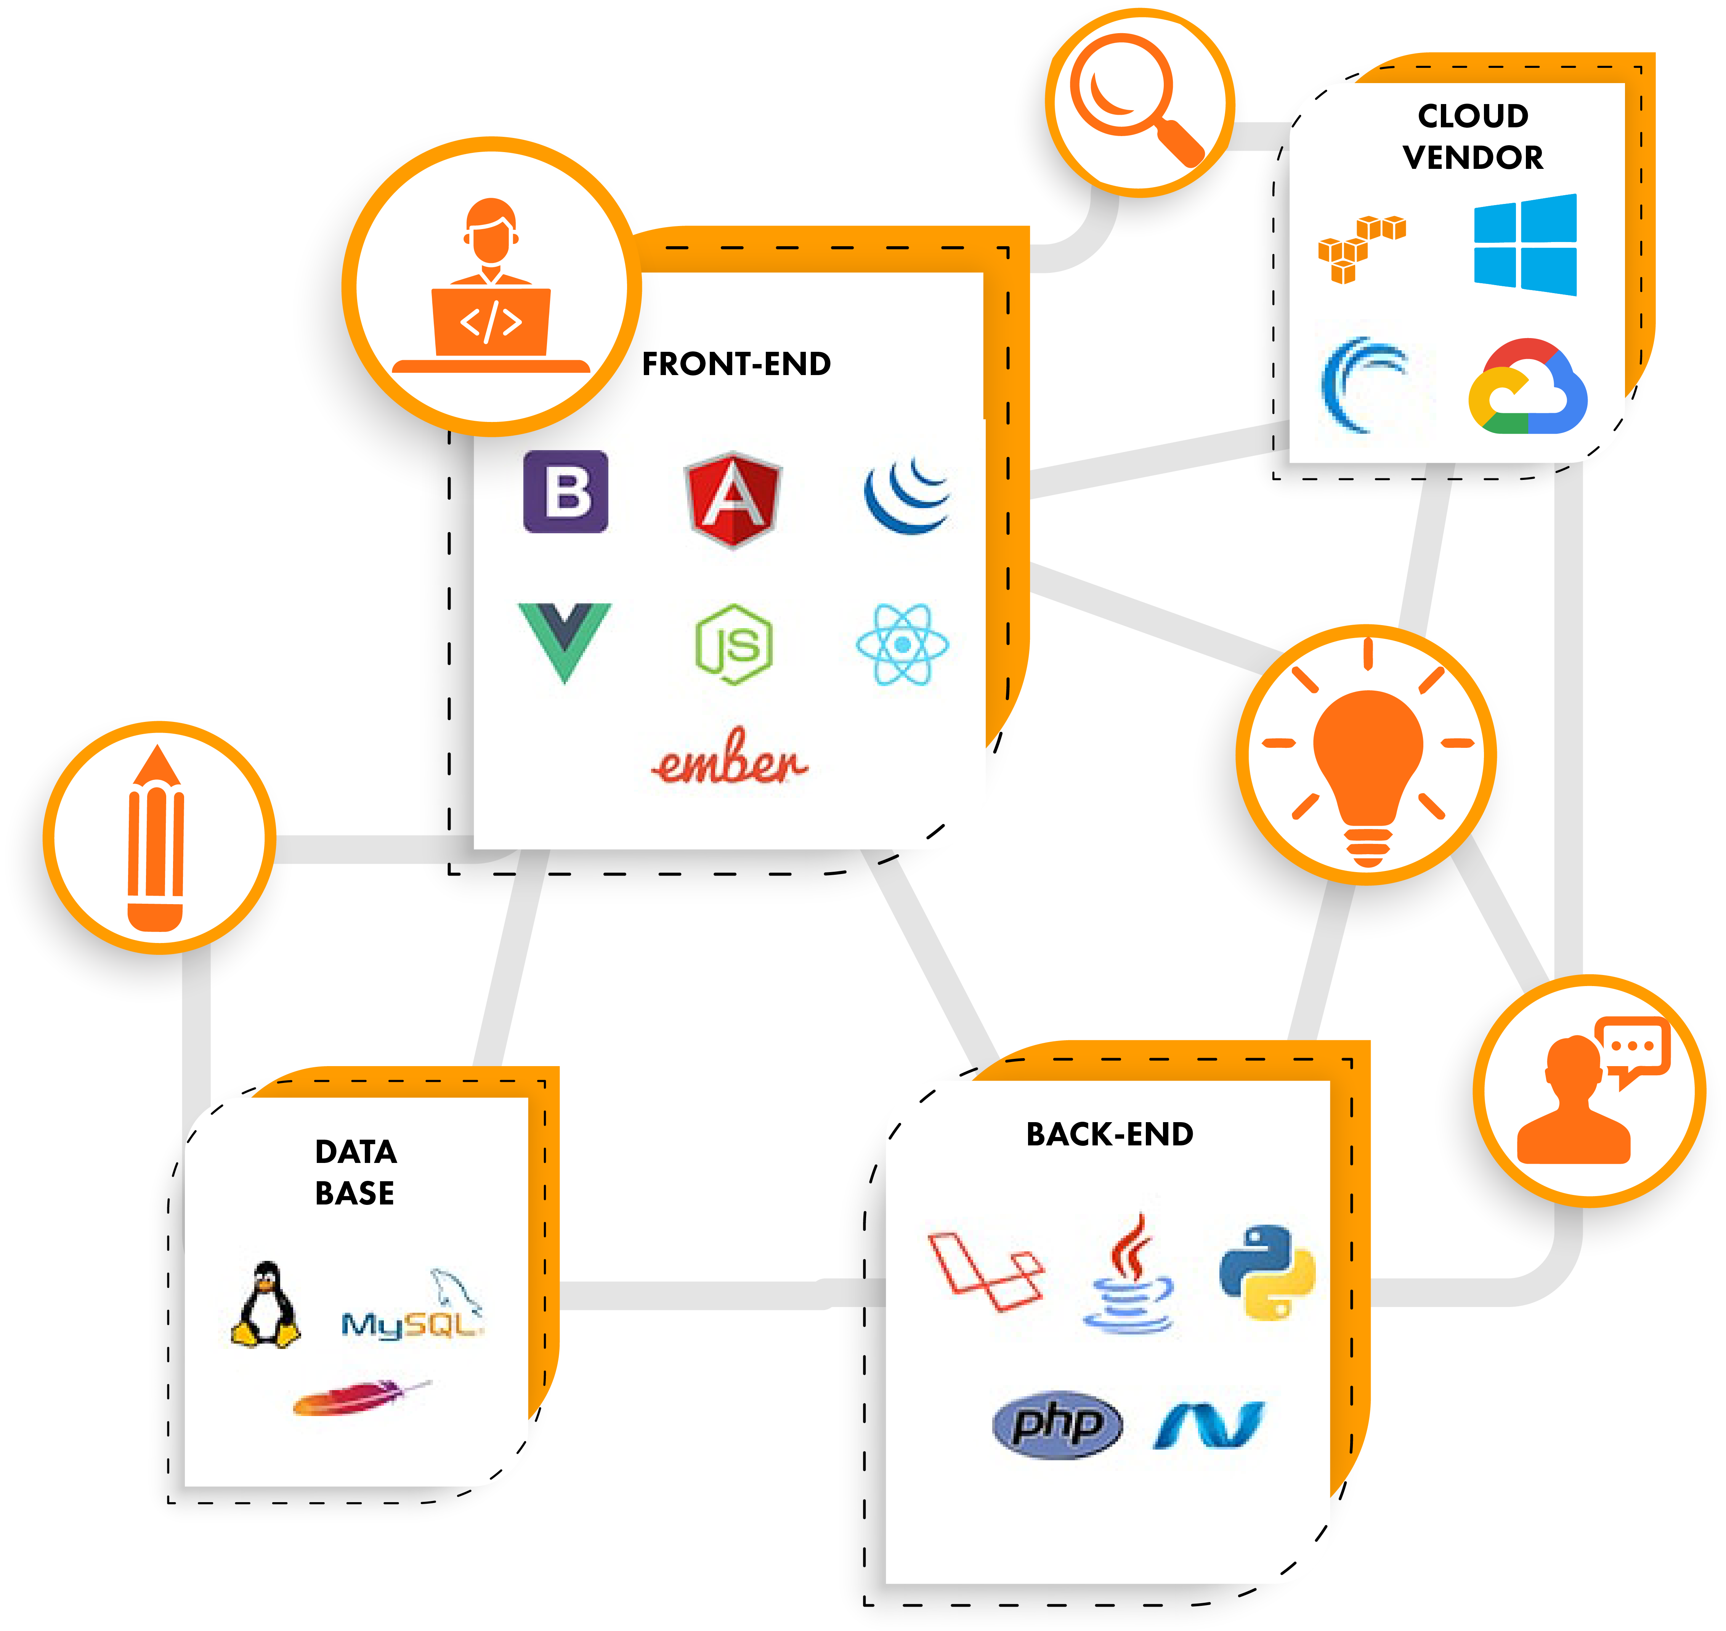

Slide 4
Software Development LifeCycle (SDLC)
A methodology used by the current industry to start making a software from an idea to an actual product.
Typically divided into 6 – 8 steps
Planning, Define Requirements, Design and Prototyping, Software Development, Testing, Deployment, Operations and Maintenance

Slide 5
SDLC Continued
Planning
Calculate if the idea is feasible both financially and current technology advancements
Lots of meetings and discussion between project leaders, stakeholders, teams, etc.
Feedback from customers
Define Requirements
Actual feasible steps required to get the finished product.
Think of features this product will have

Slide 6
SDLC Continued
Design and Prototyping
Defining what technologies, you will utilize to create the product
There are many different market/companies/products/technologies that offer the same thing but a little bit different
Software Development
Actual code writing to make the product
Testing
Creating test cases to check that the finished product can satisfy the defined requirements
Best way to verify that your finished product will have all the features you planned in the beginning

Slide 7
SDLC Continued
Deployment
Create a way to get your finished product in the hands of the customers
Mostly automated for us
HOWEVER, this step is very important because it can make or break a product’s impressions
Ex: Creating a website or a whole logistical plan to get finished products from the factories to the stores
Operations and Maintenance
Users may find bugs that needs fixing later
We can add future updates to our apps as well

Slide 8
Waterfall Methodology
One of the popular SDLC model first introduced in the 1970s that is still used today
Each phase needs to be completed in order and will not proceed to the next phase until finish
A more linear approach
Pros | Cons
Simple model to follow | Consumes a lot of time and thinking per phase since you can’t go back
All the phases are clearly defined and documented | Slow speed of development and no flexibility

Slide 9
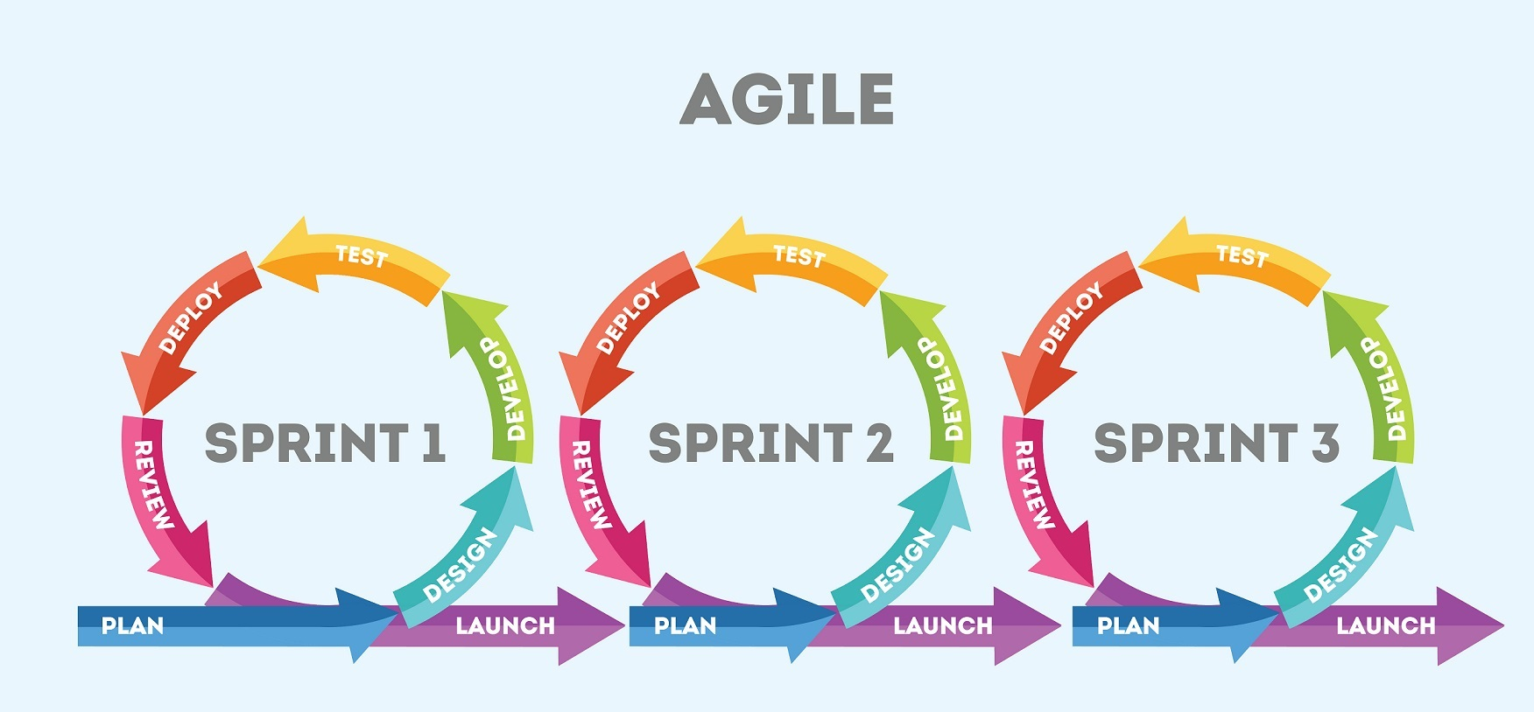
Agile Methodology
The current leading SDLC that most companies follow
You focus on a subset of features and go through each phase until you can deploy
Focuses strongly on user experience and feedback
Pros | Cons
Flexible and responsive | Unclear timeframes and deadline
Fast deployment of product | Huge amount of communication required

Slide 10
Fundamentals of an Operating System (OS)
It is software that allows you to communicate with the hardware of your computer
Essentially, OS boots up your computer
Main OS used by today: Windows OS, macOS, and Linux
Why is this important to us developers?
Optimizing code needs a firm understanding on how your OS interacts with your hardware

Slide 11
Linux Commands
One of your main ways of interacting with your computer
Flags are used to change the behavior of a command
pwd – shows the current location of your terminal
Ls – lists files and directories
Cd – Changes the current directory
Mkdir – Creates a directory
Touch – creates a file
Cat – views the file (also can combine two files together)

Slide 12
Linux Commands Cont.
Cp – copies a file and paste it on a specified location
Mv – move a file to a directory
Rm – removes a file (use –r to remove a directory and all its content)
Diff – shows the difference between two files line by line
Grep – Searches for specific texts within a file and prints that entire line

Slide 13
GIT
A popular Version Control System (VCS)
A way to track and save all the changes to specific files that pertains to a project
If mistakes were made, we can always restore back to a previous version
We can also compare the two version and see what caused the bug based on the difference
Three states:
New/Modified – a new file was added or changed
Staged – Files added to this state will be ready to be committed
Committed – means the data is permanent and saved

Slide 14
Git Commands
Every command will start with “git”
Git init – initializes git and create a repository
Git status – Checks the current state of each file
Git add – tracks new/modified files within the repo (git add . Will add all files into staging)
Git commit –m “message” – commits all the changes we have done and attach a message to it

Slide 15
Github
Github and Git are NOT the same
Github is a remote repository
It stores your repository online
Mainly used to share your application to multiple people
Multiple people can also contribute to the remote repository
Extremely easy to share and track all the changes
It has tools to also change files in your remote repository as well as other more advance tools

Slide 16
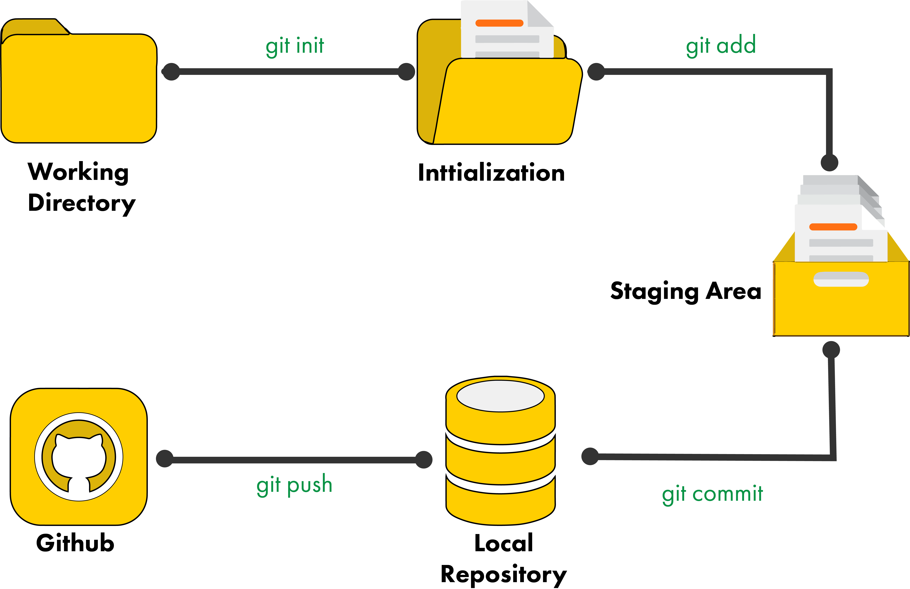
Pushing into a Remote Repo
Git remote add origin [URL] – Establishes the location of your remote repo
Git push –u origin master – Will push current version of your local repo to the remote repo
Git Workflow

Slide 17
Exercise
Do the following using only the Only Git Bash
Create a folder named GitExercise within Revature directory
Create three files within the folder named dog1, dog2, dog3
Add text within those three files
Each file should write Bark depending on the number at the end of the file name
Ex: dog1 will contain Bark, dog2 will contain Bark Bark, etc.
Create and push a remote repository named as Firstname-Lastname-Git containing all 3 dog files
Bonus: edit dog1 and dog2 and type a new line with more Barks but dog2 should be the only one changed in your remote repository.

Slide 18
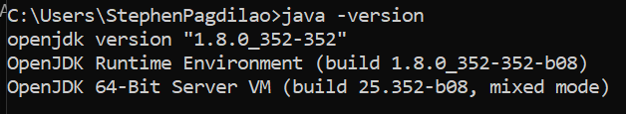
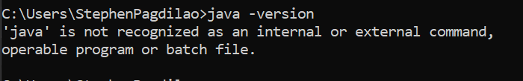
Challenge
Install java JDK utilizing the document, videos, or any helpful sites you find
Type java –version on your terminal and if you installed it correctly, it should display
If you did not install correctly, it would display

Slide 19
Exercise – Grading calculator
Create a Grader class
It is responsible for obtaining x number of grades and calculating the average
It should have at least one int array field
It should have at least one constructor
It should have a parameter that determines the size of the int array field
It should have one method named getAverage()
This method will return the current average
Your main method should test if your Grader class is working as intended and print the results in the terminal

